Slide 1
Database & Storage Security
Dr. Mohammad Abu Yousuf
yousuf@juniv.edu

Slide 2
Managing and Querying Encrypted Data

Slide 3
Introduction
  Encryption ensures confidentiality
  It has overhead
    Selection of appropriate algorithm
    Key management
    Query on encrypted data
      Comparison operation
      Arithmetic operation
      Keyword matching over encrypted data.
  Only the encryption techniques can not work well.

Slide 4



Introduction
Data As a Service (DAS) model:
Application Service Provider
Data Service Provider
client

Slide 5
Introduction
Data As a Service (DAS) model:
  Data owned by a client is hosted on a third-party server.
  Third Party Service Provider maintains the availability of the system.
  Client will have access to the data as and when required.
  Client will only use the system on rental basis.

Slide 6
Introduction
Data As a Service (DAS) model:
  Confidentiality for sensitive data to be ensured.
  Client hides the sensitive portion of the data at the server side.
  Server side DBA will not get access to these sensitive & confidential data in plaintext form.

Slide 7
Introduction
Two new challenges emerge:
  Efficient encryption algorithms for relational data
  Supporting query on the encrypted relational data.

Slide 8
Introduction
An application that has driven a lot of research in the cryptographic community is that of keyword-matching over encrypted text data.
Example : Secure email Service
    Email server stores emails of Account holders in encrypted format.
    It allows users to search emails based on keywords without having to decrypt the documents on the server.
    The returned email then can be decrypted at the client’s machine.

Slide 9
Introduction
Examples: Secure Personal Storage Service
  Applications have been developed to let individuals store a variety of data on remote servers and
  Access them over the network securely from any place.

Slide 10
Introduction
Examples: Secure Personal Storage Service
  pVault
    stores and manages an individuals passwords for his online accounts.
    Supports password generation and mobile access.
  DataVault
    works as a secure network drive available online for individuals
    Google drive

Slide 11
Introduction
  Applications for securing XML data
    In case of XML, not only the data but structure is also important, which brings up new kinds of challenges.
    XML text and data travel over the insecure Internet.
    As a result, both Data and structure should be protected.
    All these bring a new challenge

Slide 12
Encrypted Data Management
Key concern:
Confidentiality of the sensitive information in the DB residing on the server.
    From outside hackers
    From malicious insiders (DBA).
Solution:
Encrypt the sensitive portions of data where only the client has access to the key.

Slide 13
Encrypted Data Management
Issues related to encrypted data management:
Support for encryption algorithm
Key management
Query execution on encrypted data

Slide 14
Architecture of a typical DAS system:
DAS - Storing and querying encrypted data
The DAS model offers a variety of data management functionalities in the form of service to clients.
A key concern in such an application is that of confidentiality of the sensitive information in the database residing on the server.
In many cases, some or all of the data might be considered sensitive and needs to be protected from any kind of unauthorized access on the server side.
“Unauthorized access” could refer to a break-in by hackers or an access by a legitimate, but malicious insider, for example a database administrator.

Slide 15
Architecture of a typical DAS system:
DAS - Storing and querying encrypted data
DAS set up and security model
Querying encrypted relational data
Relational encryption and storage model
Keyword search on encrypted text data
Search over encrypted XML data

Slide 16
DAS setup and security model
Data-owner
  One or more clients.
Server: owner stores the data on the server.
Clients may query/modify parts of the data remotely according to their access rights.
Data must be encrypted on the server and only decrypted on the client-side.
Notes:
Trong hau het cac mo hinh, client rat an toan va dang tin, nen moi de doa thi den tu phia server adversary,

Slide 17
DAS setup and security model
In DAS Application, the client/owner side environment is assumed to be secure and trusted.
Main problem from server side adversaries
  A malicious DBA can harm the data owner.
  Sensitive portion of the data must be in encrypted format on the server at all the time.
  Secret encryption key should remain with the client.
  Data is only decrypted on the client side.
Notes:
Trong hau het cac mo hinh, client rat an toan va dang tin, nen moi de doa thi den tu phia server adversary,

Slide 18
Querying Encrypted Relational Data
Suppose an user (Alice) is outsourcing the following tables:
EMP(eid, ename, salary, addr, did)
DEPARTMENT(did, dname, mgr)
These tables are stored at the service provider.
Since the service provider is untrusted, the relations must be stored in an encrypted form.
It is assumed that each row is encrypted as a single unit.
Thus we have a set of encrypted records at the server.
Notes:
Alice muon truy van thi no gui yeu cau cho server gui co so du lieu cho no, sau do Alice giai ma va thuc thi cau lenh.

Slide 19
Querying Encrypted Relational Data
Client’s (Alice) query execution:
SELECT SUM(E.salary)
FROM EMP as E, DEPARTMENT D
WHERE E.did=D.did AND D.mgr=“Bob”:
The goal in DAS is to process the query directly at the server without the need to decrypt the data.
Notes:
Alice muon truy van thi no gui yeu cau cho server gui co so du lieu cho no, sau do Alice giai ma va thuc thi cau lenh.

Slide 20
Querying Encrypted Relational Data
An approach Alice could use to evaluate such a query might be to request the server for the encrypted form of the EMP and DEPARTMENT tables.
The client could then decrypt the tables and execute the query. This however, would defeat the purpose of database outsourcing, reducing it to essentially a remote secure storage.
Instead, the goal in DAS is to process the queries directly at the server without the need to decrypt the data.

Slide 21
Querying Encrypted Relational Data
Basic operator in query language:
    Comparison operators
      (=, ≠, <, ≤, >, ≥)
      Compare attribute values with of a given record with constraints
        DEPT.sal > 45000 as in select query.
    Arithmetic operators
      (+, -, x, /)
Notes:
Thach thuc 2

Slide 22
Querying Encrypted Relational Data
SELECT SUM (E.salary)
from EMP as E, DEPT as D
WHERE E.did = D.did AND D.mgr = “Bob”
Illustrates both classes of operators.
Notes:
Thach thuc 2

Slide 23
Mechanism to Support the Operators
First challenge:
To develop mechanisms to support comparison and arithmetic operations on encrypted data.
Two categories:
Approaches based on new encryption techniques.
Information-hiding based Approaches.
Notes:
Cac ky thuat ho tro phep so sanh voi toan tu so hoc duoc chia lam 2 loai

Slide 24
Approaches based on new encryption techniques
Support either arithmetic and/or comparison operators
  PH (Privacy Homomorphism) supports basic arithmetic operations, and doesn‘t allow comparison.
  Order-preserving encryption: support comparison, join, selection, sorting, grouping, not support aggregation.
    Can’t support aggregation on server side.
The limitation:
  Only safe under limited situations where the adversary knowledge is limited.
Notes:
PH: 1 trong cac ky thuat dau tien,

Slide 25
Information-hiding based Approaches
Stores additional auxiliary information along with encrypted data to facilitate query evaluation at the server side.
It may reveal partial information about the data to the server.
Such auxiliary information are stored in the server in the form of secure indices.
Secure indices are designed carefully exploiting information hiding mechanism .
Notes:
- Nhung thong tin phu nay duoc luu tru duoi dang indice(goi la chi so an toan), co the tiet lo 1 phan thong tin ve du lieu doi voi server
De han che viec thong tin bi tiet lo

Slide 26
Information-hiding based Approaches
Three techniques (Disclosure Control Methods):
  Pertubation : For a numeric attribute of a record, add a random value to the true value (numeric attribute).
  Generalization: Replace a numeric or categorical value by a more general value
  Swapping: swap the values of a specific attribute of two records
Notes:
- Generalization duoc su dung chinh.

Slide 27
Difference between Disclosure Control method and Cryptographic approach
In cryptographic approach, if it is broken (disclosure of key), whole information is disclosed.
In disclosure control method, there may partial disclosure of information or probabilistic in nature.
Notes:
Nhieu bai viet da co gang ket hop phuong phap nay voi PH de ho tro phep tap hop cung nhu S.PJ.Khi ket hop voi PH thi ky thuat nay de bi tan cong

Slide 28
Difference between Disclosure Control method and Cryptographic approach
Cryptographic approach works well for arithmetic operations.
Information hiding approach works well comparison operation.
However, information hiding approach can not exactly identify the aggregation target group
Notes:
Nhieu bai viet da co gang ket hop phuong phap nay voi PH de ho tro phep tap hop cung nhu S.PJ.Khi ket hop voi PH thi ky thuat nay de bi tan cong

Slide 29
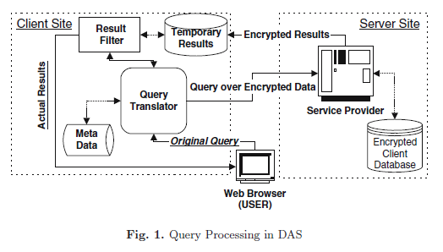
Query Processing Architecture for DAS
Notes:
Gom 3 phan tu chinh : user ,client ,server .client luu du lieu tren server(luon o dang ma hoa).
Co so du lieu ma hoa duoc gan them thong tin phu de cho phep xu ly truy van ma bao ve privacy.Client chua cac metadata de chuyen yeu cau cua user thanh mot dang thich hop va bieu dien ket qua cua server

Slide 30
Query Processing Architecture for DAS
Information hiding technique is used.
Three entities: user, client and server
The client stores the data at the server which is hosted by the service provider.
Data is stored in encrypted format in the server at all the time.
The encrypted database is augmented with additional information(secure indices) that allows certain amount of query processing at the server level.
Notes:
Gom 3 phan tu chinh : user ,client ,server .client luu du lieu tren server(luon o dang ma hoa).
Co so du lieu ma hoa duoc gan them thong tin phu de cho phep xu ly truy van ma bao ve privacy.Client chua cac metadata de chuyen yeu cau cua user thanh mot dang thich hop va bieu dien ket qua cua server

Slide 31
Query Processing Architecture for DAS
The clients also maintains a metadata for
  translating user queries to the appropriate representation on the server and
  performs post-processing on server query results.
Notes:
Gom 3 phan tu chinh : user ,client ,server .client luu du lieu tren server(luon o dang ma hoa).
Co so du lieu ma hoa duoc gan them thong tin phu de cho phep xu ly truy van ma bao ve privacy.Client chua cac metadata de chuyen yeu cau cua user thanh mot dang thich hop va bieu dien ket qua cua server

Slide 32
Query Processing Architecture for DAS
Based on the auxiliary information stored, original query over un-encrypted relations are broken into:
A server-query over encrypted relations which run on the server and
A client-query which runs on the client and post processes the results returned after executing the server query.
Notes:
Gom 3 phan tu chinh : user ,client ,server .client luu du lieu tren server(luon o dang ma hoa).
Co so du lieu ma hoa duoc gan them thong tin phu de cho phep xu ly truy van ma bao ve privacy.Client chua cac metadata de chuyen yeu cau cua user thanh mot dang thich hop va bieu dien ket qua cua server

Slide 33

Relational Encryption and Storage Model
For each relation, one stores on the server an encrypted relation.
R(A₁, A₂,.., A_{n}) →
where the attribute etuple stores an encrypted string that corresponds to a tuple in relation R.
Each attribute A^{s}_{i} corresponds to the index for the attribute A_{i} and is used for query processing at the server.
Notes:
Etuple luu mot chuoi da ma hoa tuong ung voi 1 row cua R.
Ai(S) tuong ung voi index cua Ai, duoc su dung cho qua trinh truy van o server

Slide 34
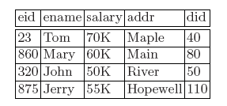
Relational Encryption and Storage Model
Example:
Emp(eid, ename, salary, addr, did)
EMP table is mapped to a corresponding table at the server.
Emp^{S} (etuple, eid^{S}, ename^{S}, salary^{S}, addr^{S}, did^{S})
It (Emp^{S} ) is only necessary to create an index for attributes involved in search and join predicates.
Notes:
Etuple luu mot chuoi da ma hoa tuong ung voi 1 row cua R.
Ai(S) tuong ung voi index cua Ai, duoc su dung cho qua trinh truy van o server

Slide 35

Relational Encryption and Storage Model
Partition functions:
  Partition( R, A_{i}) = { p1, p2,…………. p_{k}}
  Partition (emp.eid) = {[0,200], [200,400] , [400,600], [600, 800], [800, 1000]}

Slide 36
Relational Encryption and Storage Model
As an example, consider the attribute eid of the emp table above.
Suppose the values of domain of this attribute lie in the range [0, 1000].
Assume that the whole range is divided into 5 partitions, represented as:
  Partition (emp.eid) = {[0,200], [200, 400],[400,600],[600, 800], [800, 1000]}
  Different attributes may be partitioned using different partition functions.

Slide 37
Relational Encryption and Storage Model
The strategy used to split the domain into a set of buckets has profound implications on both the efficiency of the resulting query processing as well as on the disclosure risk of sensitive information to the server.

Slide 38
Relational Encryption and Storage Model
Identification functions:
Randomly selected numbers. An identification function called ident assigns a random, unique identifier ident_{R}._{Ai} (pj) to each partition pj of attribute A_{i}.
E.g. : Ident(emP,eid)([0,200]) =2

Slide 39
Relational Encryption and Storage Model
Mapping functions:
Given the above partition and identification functions, a mapping function Map_{R.Ai} maps a value v in the domain of attribute A_{i} to the identifier of the partition to which v belongs: Map_{R.Ai} (v) = ident_{R.Ai} (p_{j} ),
where p_{j} is the partition that contains v.
  Map(emp.eid)(23) = 2, Map(emp.eid)(864) = 4, Map(emp.eid)(320) = 7, Map(emp.eid)(875) = 4

Slide 40
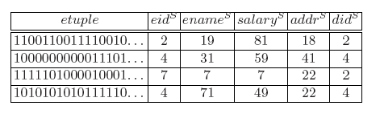
Relational Encryption and Storage Model
Storing encrypted data:
For each tuple t = a1, a2, . . . , an in R, the relation R^{S} stores a tuple:
Notes:
Server-side luu lai cac dong ma hoa, va cac indice cua thuoc tinh duoc xac dinh boi mapping function, client luu sieu du lieu ve cac indice nhu thong tin ve mapping function, cac partition cua thuoc tinh

Slide 41
Relational Encryption and Storage Model
The first column etuple contains the string corresponding to the encrypted tuples in emp. For instance, the first tuple is encrypted to “1100110011110. . . ” that is equal to encrypt(23, Tom, 70K,Maple, 40).

Slide 42
Relational Encryption and Storage Model
Decryption functions:
  Given the operator E that maps a relation to its encrypted representation, its inverse operator D maps the encrypted representation to its corresponding decrypted representation i.e. D(R^{s}) = R.
  D(emp^{S}) = emp
  Decryption will regenerate the whole record.
Notes:
Server-side luu lai cac dong ma hoa, va cac indice cua thuoc tinh duoc xac dinh boi mapping function, client luu sieu du lieu ve cac indice nhu thong tin ve mapping function, cac partition cua thuoc tinh

Slide 43
Relational Encryption and Storage Model
Mapping condition:
To translate query conditions in operations (Selections, joins etc.) to corresponding conditions over the server-side, Map (cond) is used.
It helps translate relational operators for server side implementations and how query trees are translated.
Notes:
Server-side luu lai cac dong ma hoa, va cac indice cua thuoc tinh duoc xac dinh boi mapping function, client luu sieu du lieu ve cac indice nhu thong tin ve mapping function, cac partition cua thuoc tinh

Slide 44
Relational Encryption and Storage Model
Mapping condition:
For each relation, the server-side stores the encrypted tuples, along with the attribute indices determined by their mapping functions.
The client stores the meta data about the specific indices, such as the information about the partitioning of attributes, the mapping functions, etc. The client utilizes this information to translate a given query Q to its server-side representation Q^{S}, which is then executed by the server.

Slide 45
Translating Relational Operator
Strategy: To partition the computation of the operators across the client and the server such that a superset of answers is generated by the operator using the attribute indices stored at the server.
This set is then filtered at the client side after decryption to generate the true results.
The goal is to minimize the work done at the client.
Notes:
Client dich dieu kien C thanh dieu kien C’ nho vao ham Map Condition va metadat, sau do chuyen cho server va server thuc thi cau lenh select dua tren cac chi so cua thuoc tinh, gui ket qua ve cho client, client sau do loc lai ket qua cuoi cung

Slide 46

Translating Relational Operator
The Selection Operator:
Partially compute the selection operator at the server using the indices associated with the attributes in C and push the result to the client.
The client decrypts the result and filters out tuples that do not satisfy C.
The decryption operator D will only keep the attribute etuple of R^{S} and drop all other A_{i}^{S} attributes.
Notes:
Client dich dieu kien C thanh dieu kien C’ nho vao ham Map Condition va metadat, sau do chuyen cho server va server thuc thi cau lenh select dua tren cac chi so cua thuoc tinh, gui ket qua ve cho client, client sau do loc lai ket qua cuoi cung

Slide 47
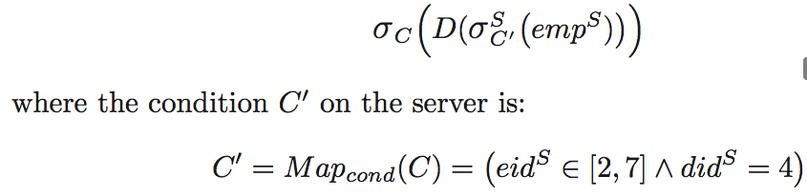
Translating Relational Operator
The Selection Operator:
E.g. :C = eid < 395 & did = 140 (emp)
The selection operation can be translated into:
Notes:
Client dich dieu kien C thanh dieu kien C’ nho vao ham Map Condition va metadat, sau do chuyen cho server va server thuc thi cau lenh select dua tren cac chi so cua thuoc tinh, gui ket qua ve cho client, client sau do loc lai ket qua cuoi cung

Slide 48

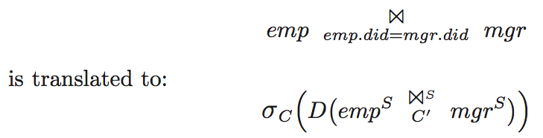
Translating Relational Operator
The Join Operator:
Example:
Notes:
Client dich dieu kien C thanh dieu kien C’ nho vao ham Map Condition va metadat, sau do chuyen cho server va server thuc thi cau lenh select dua tren cac chi so cua thuoc tinh, gui ket qua ve cho client, client sau do loc lai ket qua cuoi cung

Slide 49
Query Execution
Objective:
Come up with the best query plan that minimizes the amount of work to be done at the client side.
Given a query Q, the goal is to split the computation of Q across the server and the client.
Cost of a query:
I/O & CPU cost of evaluating the query at the server.
Network transmission cost
I/O & CPU cost at the client.
Notes:
Muc dich la chia nho cac tinh toan cua truy van Q giua client va server ,server se thuc thi nhieu nhat cac truy van co the ,sau do se chuyen cac phan tinh toan con lai cho client han che toi thieu cong viec phai lam cho client

Slide 50

Query Execution
As an example, consider the following query over the emp table than retrieves employees whose salary is greater that the average salary of employees in the department identified by did = 1.

Slide 51
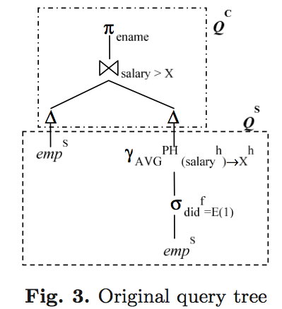
Query Execution
Client fetches emp table & filters the records that matches the average salary.
Server computes average salary & passes it to client.
Notes:
Server dua bang emp cho client

Slide 52
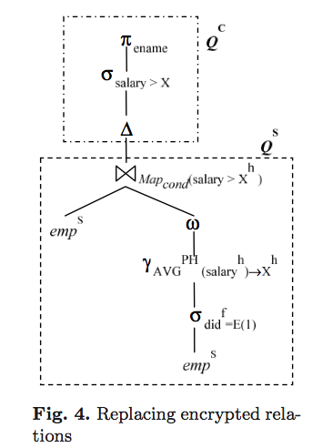
Query Execution
Server does both average salary calculation as well as filtering the records that matches with the average salary.
Notes:
Server dua bang emp cho client

Slide 53
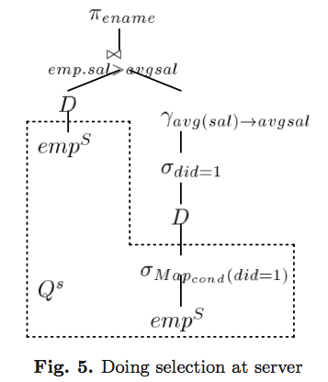
Query Execution
Client imports encrypted table, decrypts it and runs the query filtered by average salary
Client decrypt the result & computes average salary
Compute inner query at server
Notes:
Server xu ly cau truy van ben trong sau do gui ket qua cho client

Slide 54
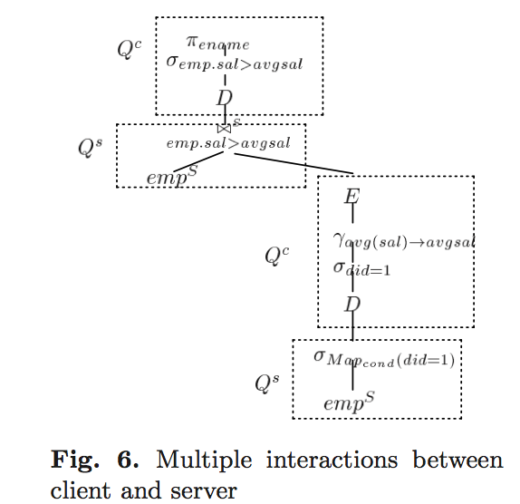
Query Execution
Results are decrypted at the client
Average salary is encrypted by client & shipped to server which computes the join at the server.
Results are shipped to client which decrypts the tuples and computes average salary.
Evaluate the inner query at the server
Notes:
Server xu ly cau truy van ben trong sau do dua cho client ,client giai ma roi tinh luong trung binh ,ma hoa luong trung binh roi gui cho server ,sau do server thuc hien phep join roi gui tra ve cho client.

Slide 55
Supporting Aggregation Operators in Queries
Information hiding techniques do not work for arithmetic operators (aggregation) but works well in comparison operators.
Encryption based approached (PH) works well in arithmetic operation (aggregation) but can not handle comparison operation.
If aggregation is to be performed at the server side, information hiding approach has to be augmented with an encryption approach that supports arithmetic operation on encrypted representation.

Slide 56
Supporting Aggregation Operators in Queries
Again as information hiding approach can not exactly identify the aggregate target group to be aggregated, we may separate it into two subsets – one that qualifies the conditions specified in the query and another that may or may not satisfy the selection predicates of the query.
The first may be directly aggregated at the server side using PH while the tuples belonging to the second category will need to be transmitted to the client side to determine if they need to satisfy the query condition.

Slide 57
Query Optimization in DAS
Cost based optimization model.
New query processing functions and new query translation rules that defines transfer of tuples from server to client and decryption at the client as operators in the query tree.
Given different hardware constraint and software capabilities at the client and server, different cost measures are applied to the client side and server side computations.
A novel query plan enumeration algorithm is developed that identifies the least cost plan.

Slide 58
Keyword search on encrypted text data
Collection of text documents to be stored in the server:
D = {D₁,D₂,D₃ . . . , D_{n}}
Where a document is modeled as set of keywords
D_{i} = {W^{D}₁, W^{D}_{2,} W^{D}₃...,W^{D}_{n}},
Each word w ∈ W and W is a set of all possible keywords.

Slide 59
Keyword search on encrypted text data
Each document is encrypted at the word level as follows:
Each document is divided into equal length words (W) with extra padding 0 or 1.
If we submit a query to the server, following subset of documents are expected to come :
Ans(q) = {D_{i} ∈ D|∀k_{j} ∈ q,k_{j} ∈ D_{i}}
Where k_{j} is the keyword in the query
Private key based encryption schemme is used to design a matching technique on encrypted data that can search for any word in the document.

Slide 60
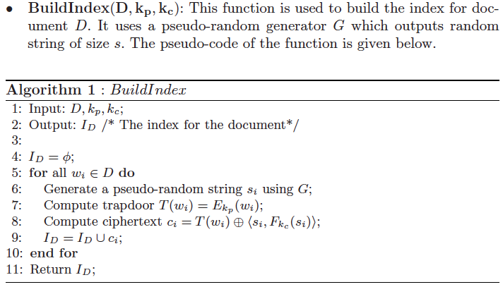
Private Key based search scheme on encrypted text data

Slide 61
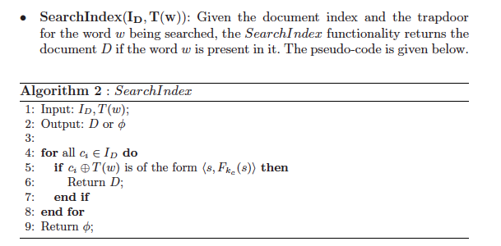
Private Key based search scheme on encrypted text data

Slide 62
Trapdoor Function
A trapdoor function is a function that is easy to perform one way, but has a secret that is required to perform the inverse calculation efficiently.
That is, if f is a trapdoor function, then y=f(x) is easy to compute, but x=f⁻¹(y) is hard to compute without some special knowledge k.
Given k, then it is easy to compute y=f⁻¹(x,k).

Slide 63
Trapdoor Function
The analogy to a "trapdoor" is something like this: It's easy to fall through a trapdoor, but it's very hard to climb back out and get to where you started unless you have a ladder.
A hash function is not a trapdoor function because it is not reversible. Instead, it's called a one-way function. A one-way function is similar to a trapdoor function in that it's easy to compute both and it's very hard to reverse both, but there is no special key that allows you to reverse the one-way function.

Slide 64
Thank you

